Slide 1
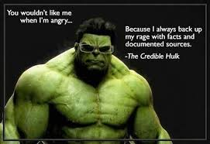
How to … Evaluate sources

Slide 2
Why we evaluate sources
Validity of information
Bias of information
Making sure we aren't sharing misinformation
Checking that the conclusions we have are accurate
Making sure that the data supports the conclusions shared
Being careful to not fall under propaganda
Example: Climate change https://news.northwestern.edu/stories/2022/07/false-balance-reporting-climate-change-crisis/
In this day and age anyone can say anything on the internet, it's no longer that info is checked before shared
There is a huge issue with AI giving information that is junk and inaccurate so we need to find where the info is coming from and make sure it's been checked by someone knowledgeable in that arena

Slide 3
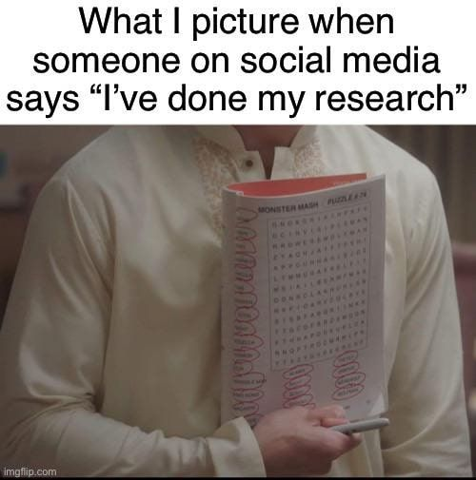
Why it's important to use good sources
Making sure that the data has been analyzed properly by someone that knows what they are doing
Making sure that the data and conclusions were verified by more than one person
Making sure the source is reputable not just AI driven spam or a company trying to get money
For example: some companies publish information that is inaccurate just to sell their products
Some journals and publications are pay to play
Making sure the work was done by experts in the field, not just random keyboard warriors

Slide 4
The difference between AI, Search Engines and research databases
AI
It's only as good as it's sources
It has no checks or oversight, only can compile what was put in
Doesn't understand "relevance" only can parrot back info
Search engines
Use an algorithm to decide which links to give you
No checks on accuracy of links or info, you have to decide if you think the link/writer is trustworthy
Research databases
Should only have articles that have been checked and peer reviewed
Have to be careful of Pay to Play publications

Slide 5
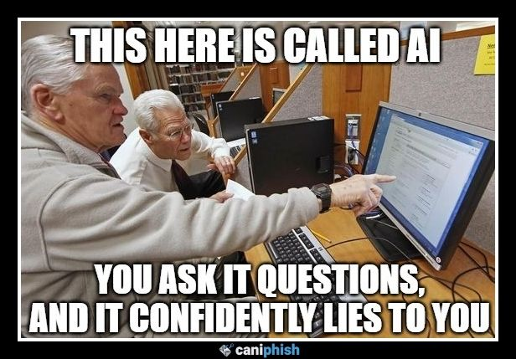
AI sources and how AI gets info
AI technically doesn't learn, it's trained by looking through hundreds and thousands of pieces of information during the training phase
Training is done by giving it info from anything the creators can get their hands on, not always reputable (such as images from social media and art from artists without asking)
The results are just compilation of info and patterns recognized
Example: Lawyer used AI for their arguments and cited fake court cases
https://natlawreview.com/article/lawyers-sanctioned-citing-ai-generated-fake-cases

Slide 6
Search Engines and how they give links
Search engines go through what's available on the internet and then adds it to its internal list and uses an algorithm to decide what it thinks are the most important
Algorithms have changed over the years, from the simple keyword searches of the 90s, to the more tailored versions of today that take user behavior into account
Search engines are also incorporating more and more AI into both the algorithms and what it shows on page 1, most people don't go past page 1
SEO (Search Engine Optimization) affects the order things come up in, and it changes all the time, it's not based on accuracy of data mostly it's based on how many links link there, or how often people click the link for that search
Search engine algorithms are what decide what's "relevant" or not, but that's not the same thing as accurate.
For example, rage bating

Slide 7
Academic databases and news sources
Should be peer reviewed and checked, not just anyone can post
Community should have already decided if the source and data is reputable
Knowing how to find the info that's relevant is more important, the knowledge has been checked, but it can be hard to find what you want

Slide 8
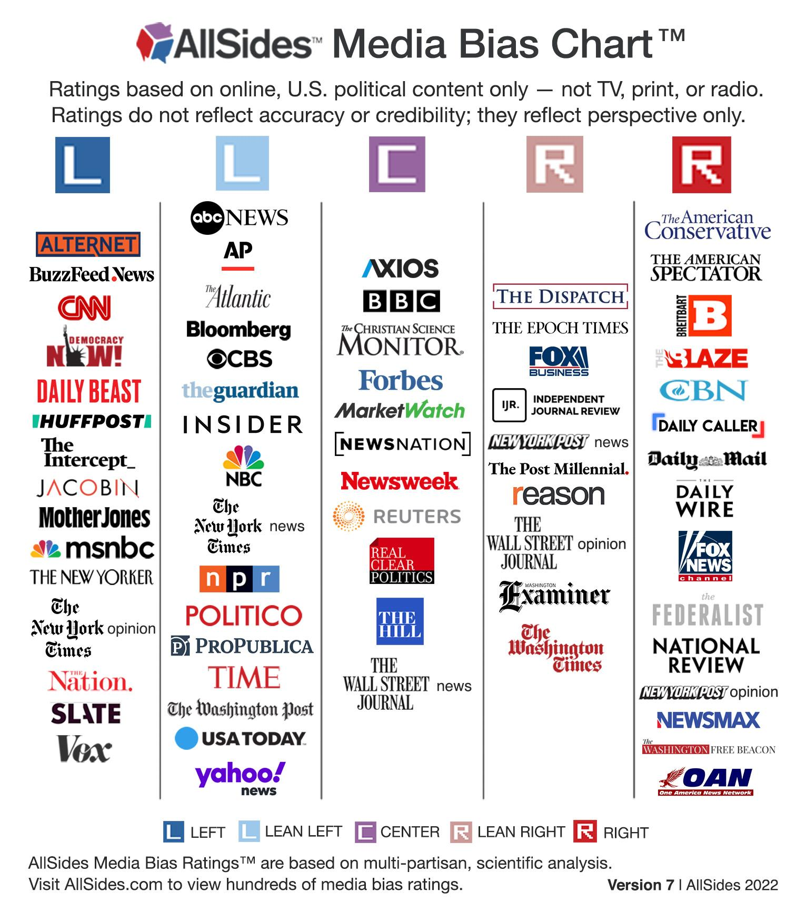
The graph of news
https://my.lwv.org/california/torrance-area/article/how-reliable-your-news-source-understanding-media-bias-2022

Slide 9
Bias and why it matters in sources
Everyone has an agenda, some are more obvious than others
Everyone has internal biases, even if we don't think we do, we do
Bias can affect everything from where the information is shared to even the words used for sharing
An unfortunate example of this is the passive voice in journalism, and how journalists tend to talk about victims and children
Bias is also an issue when it's a hot topic, because the larger the stakes the more people are inclined to lie or misconstrue results
There are a lot of types of bias, such as confirmation bias, demographic bias, and distance bias
For example: https://metro.co.uk/2016/07/07/well-done-millennials-youve-officially-ruined-handshakes-for-everyone-5991813/ Oh no! Millennials have killed the handshake!
https://mashable.com/article/things-millennials-have-killed Darn murderous Millennials

Slide 10
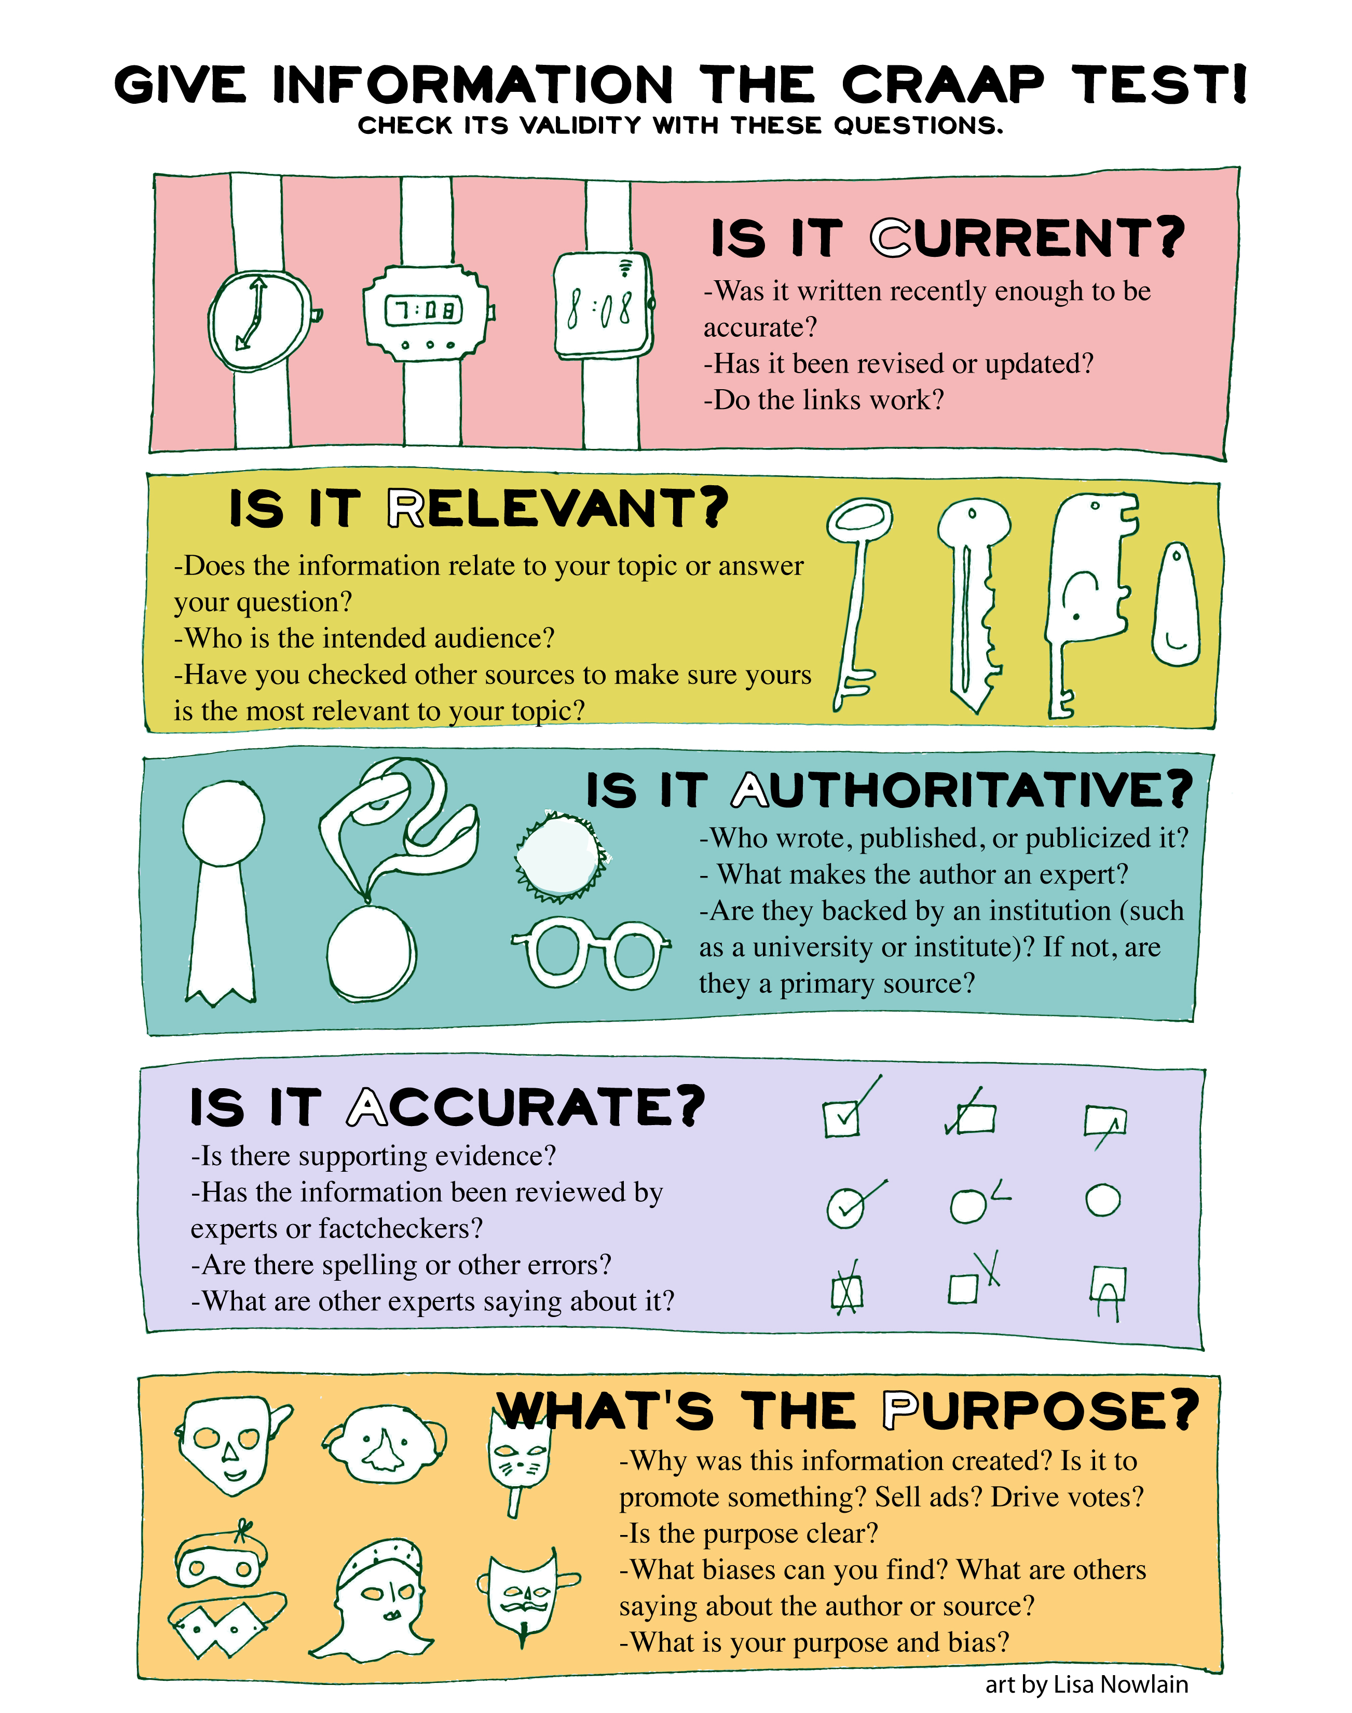
How to evaluate sources
CRAAP test
C – Currency
R – Relevance
A – Authority
A – Accuracy
P – Purpose
Designed by Sarah Blakeslee and their team
https://commons.emich.edu/loexquarterly/vol31/iss3/4/
https://www.alsc.ala.org/blog/wp-content/uploads/2020/04/craap.jpg

